Slide 1
6-10 Film trailers
George Nutt

Slide 2
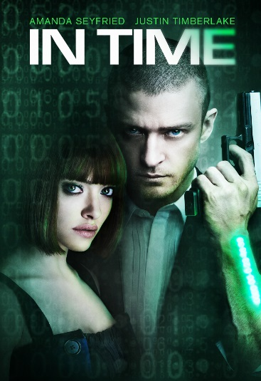
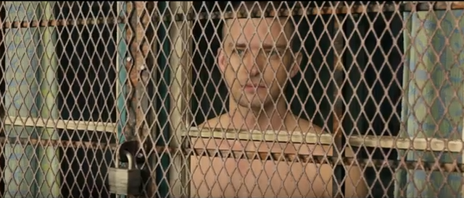
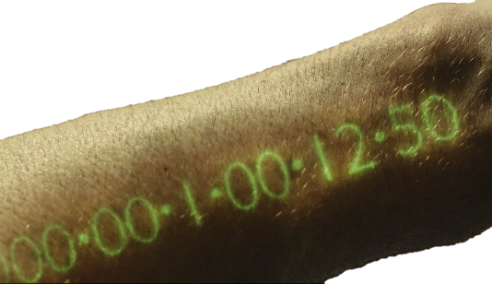
In Time
The trailer begins with the green preview screen, this is the American one and for my film trailer I will make sure to use the English bbfc screen.
There are titles that pop up which are used to describe the plot of the film, this could be helpful and I could do a similar thing for my film so it is easier for the audience to understand the plot.
There is a gold tint for when they are showing the rich people and then when they show the poor people there is then a more desaturated blueish tint. I have noticed that, from analysing film trailers and films, that this is quite common to give certain places de-saturated colour then others with more of an orange colour. However I do believe the tint is made to be gold in the trailer to represent wealth.
There are ‘glitch’ effects used to transition from one shot to another.
Some parts of the music are made to sound like a clock ticking but at the same time it fits as background music and wouldn’t usually be noticed by people who aren’t paying attention to it.
Props like guns are often used within the trailer to show to the audience that the genre is going to include a lot of action and death as well as the fact that it is a post modern film.
There is a lot of prison imagery used throughout with a mid shot of a man behind metal barrier then later on another shot of him behind a metal gate, this is possibly to show how he feels trapped and is shown to be trapped throughout the first part of the film.
There is then low key lighting at the end to show
that during the end of the film the tone will get
darker, this point is also backed up by the fact there
are lots of gun props used near the end.
Link to video

Slide 3
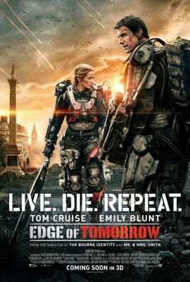
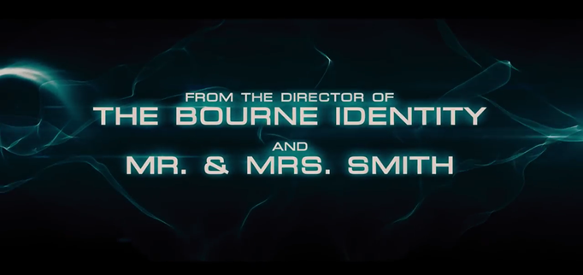
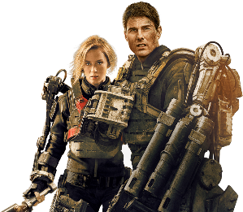
Edge of Tomorrow
Titles
Film titles
Music
Name Captions
Length
RELEASE DATE
Social Media (?)
BBFC Age Certification
Production Logos
Titles pop up throughout saying things like ‘From the director of…’ this is to heighten the expectation of the film through showing the audience that it will be the same standard as other films mentioned. This is also written in a white font but with a teal outer glow that matches the graphics in the back, I think this font matches the genre as it is square and also the teal colour is quite generic to the sci-fi genre.
The actual film title is similar to the fonts used throughout, however it has clearly had more work done on to make it more apparent, I think in my trailer I will do a similar thing.
As the trailer starts there is a establishing shot of the location to set the scene as well as a match on action where she pulls down the blanket from the helicopter which helps to emphasise how they are discovering everything as the film trailer starts like the viewers.
Costumes and props also shown a lot of the time which are the characters with mechanical armour to show the film is in a made up/ futuristic world and Emily Blunt’s character has a red suit which matches with the film titles with one part red and one part grey.
There are pleonastic sound effects with the door opening to add suspense to, there is also a very low pitch sound as the start however it is also calm and allows for the viewers to focus on things like the scenery.
At the end the titles show the release date in the same font as the other titles, on that graphic shot there are all the production company logos as well as also a link to the website and a ‘#LiveDieRepeat’ as this raises interest for the film on social media such as twitter.
Link to video

Slide 4
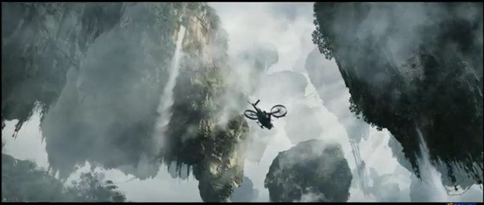
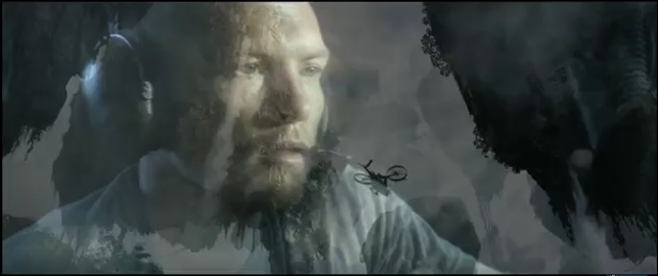
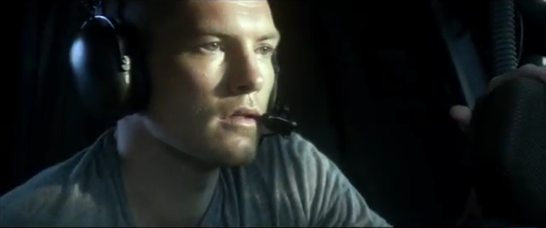
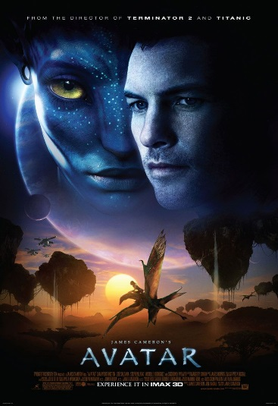
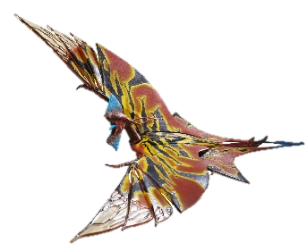
Avatar
The film starts with an animation of the production company’s logo, there is then a fade from black transition to the next extreme close up shot of the main characters eyes with narration ‘’Are you Jake Sully?” to introduce the character to the audience straight away.
There is then various shots showing the main character in his wheelchair as well as being in army uniform to show that he isn’t as able as everybody else, however he is still trying to be helpful, this gives us further character development just from the trailer.
There is a variety of transitions used to create different effects such as a fade to black when the entire location changes or dissolves used to link up shots such as the shot of the flying ship and then the shot of the character flying it, (Shown Above).
There is then a sort graphic shot of the distribution company Warner Bros which only lasts for about a second, this is then similarly done with the name of the director James Cameron where there are titles shown saying ‘Directed by James Cameron’ followed by ‘The director of Terminator’, ‘Titanic’ etc. This is so that the audience will assume that Avatar will be of equal quality of said films.
This film contains a lot of CGI and special effects and also long shots of certain costume/props that are created with the CGI such as the giant robot. The long shot is to show what the entire robot looks like and the size of it compared to the outer environment.
As well as the release date being shown at the end, it is also shown near the start of the film as this could make the date stick in their head more and there is more of a chance of them remembering when it comes out.
The length of the trailer is 3:30 which is a lot longer than the average trailer, I think this was because, at the time it was already a highly publicised film so when they released the trailer they wanted to add in as many clips as possible to satisfy the audience.
The final film title that says ‘avatar’ has a font where it looks as if it was written as a cave painting which gives the film a tribal look, this relates to the genre as the blue creatures are known as the Omaticaya tribe.
Link to video

Slide 5

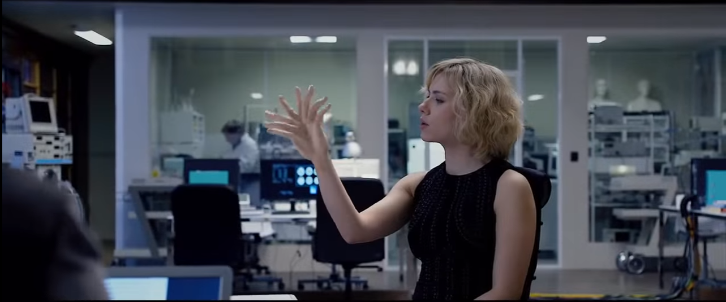
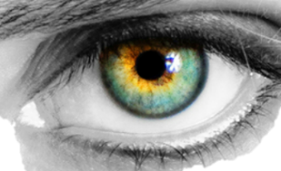
Lucy
Before the trailer begins there is the green age certification which is then followed by the film company’s logo.
The first shot is a close up of the character’s face showing disorientation and pain which instantly shows her the character is vulnerable and has possibly been kidnapped. We can also assume it is the main character as she was the first character shown.
There is then extremely pleonastic sound that synchronises with the fast paced cuts which is often done in trailers to make the trailer seem more thrilling. There is also no music until half way through the trailer, only sound effects. The music is then generic build up music used to create tension leading to the end of the trailer and therefore causing the audience to crave more.
Titles during the trailer say the names of the most famous actors as well as the production company. The final film title at the end is just one word ‘Lucy’ which is then in a sans serif plain white font as they are clearly going for a simplistic font, as well as this I also believe they are going for a simplistic style for the film as there is a lot of black and white for the posters. This is to represent the simplistic idea for the film which is that she is an all powerful being capable of doing almost anything.
There is also a lot of CGI used within this film as this to show how the main antagonist is capable of things never seen by people in real life. An example is the mid shot where it shows her with two hands coming from one arm, this is a very short cut which also adds mystery and causes the audience to want to know more.
After the title there is then one final graphic shot that shows the release month as well as the forms of social media, which in this case is only a website dedicated to the film. The production company logo is also displayed on the corner of this shot.
The trailer is 2 minutes 30 seconds and this is the average length for a film trailer and my
project will be within a similar time frame.
Titles
Film titles
Music
Name Captions
Length
RELEASE DATE
Social Media (?)
BBFC Age Certification
Production Logos
Link to video

Slide 6
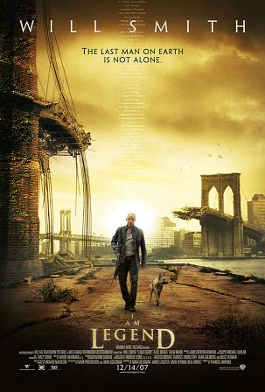
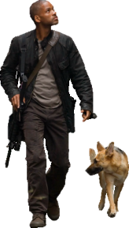
I am Legend
Cuts from black and the sound effects off police sirens and people in distress as well as the narration of somebody saying ‘I’m not infected’ gives us an idea of how the plot of the film is going to be about a virus and the genre is science-fiction horror genre.
I feel that there were no name captions because of the fact that the actor Will Smith is already very well known and his name was also on the poster for the film.
Throughout the trailer there are titles to show the routine of the character, the last title that says ‘night’ then has a black background and is synced with a low pitch sound effect, this is to give the impression that things are about to go bad and the entire tone is about to change when it becomes night.
The music is also consistent throughout apart from when it comes to the more tense part where it is similar music however it is sped up, made louder and more instruments are added.
Production company logos are shown as the trailer starts with a black background to increase the focus on them.
There are shots of the main character speaking to props like mannequins to convey how alone he is and how it has affected him mentally.
At the end of the trailer there are production logos shown again as well as the release date of the film and a web address that leads to the film’s website. This is also written in a similar or the same font to what is on the films poster as this fits with the house style of the film.
The trailer gives a glimpse of the equilibrium with the protagonist being with his family briefly, it then doesn’t hesitate to show the disruption as there is a CGI explosion on a bridge to represent the connection between the protagonist and his family has been destroyed.
Link
to
video

