Slide 1
1-5 Film trailers
George Nutt

Slide 2

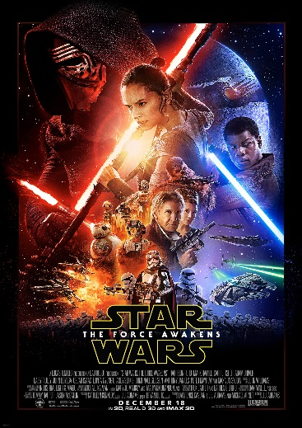
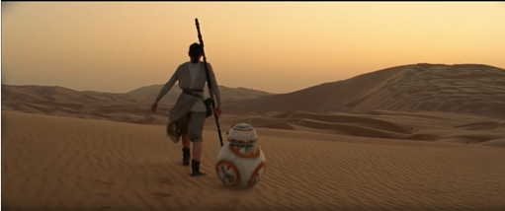
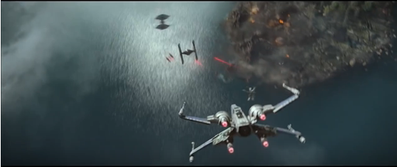
Star Wars: The Force Awakens
Link to video
It begins with synchronous sound of the music that fits with the camera cuts. Also the sound starts off calm and quiet then slowly rises to get louder as the film begins to show more of what is happening.
There is then a close up of the main character however her face is covered by her costume to add suspense to the actual reveal of the character it is also gives us no information on anything about them, including the gender so when it is revealed that the main protagonist is a girl, it is more of a surprise as it is an anti stereotype; a common convention in most films is to have a male protagonists and generally the female is seen as the weaker ‘damsel in distress’ character.
There is then a voiceover to asking the question ‘Who are you?’ which focuses the attention on who the main character is. As well as this, the use of the voiceover also reveals the voices of the new characters.
There are many establishing wide shots to show the overall mise en scene of the film with the costumes, props, lighting and locations. These are very clichéd to sci fi genre with storm troopers costume’s resembling robots and most characters were holding prop weapons that are impossible to have in reality and are used through special effects.
The location also fits with the sound as it shows a quiet empty desert when there is little music and then shows more interesting and contrasting locations when the music becomes louder.
A lot of action scenes are shown without any context so the audience can see what they will be like without the film being spoiled for them at the same time.
It shows how high budget the film is going to be by showing very ambitious locations as well as very ambitious special effects such as special effects flying and shooting.

Slide 3

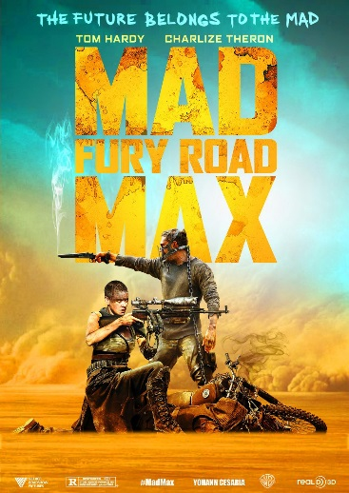
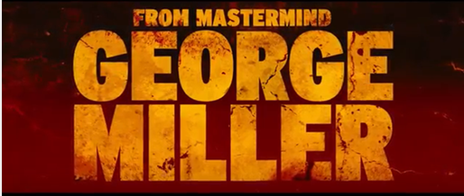
Mad Max: Fury Road
Link to video
The film begins with very fast paced cuts showing the protagonist running from the antagonists to give us an idea of how the film is going to be edited and shot.
There is then a graphic shot of the films companies but shown in the home style of the film with the colour orange which is used throughout the entire film a lot of the time with the location and possibly edited in, in post production.
It then introduces each character by showing them with a mid shot, it is also made clear which characters are going to play what role with the use of mise en scene. There is make-up so that the characters who are a bright white colour are the antagonists, also the costume of the mask on the main antagonist gives him a more intimidating look.
During the introduction of the characters, the pace of the film is slow and builds up to the middle of the trailer which is then faced paced which is also similar positioning to the Star Wars trailer.
There is also low pitch synchronous sound that matches with the fast camera cuts that help to emphasise the explosions, the action and the fighting that is going on.
Certain props are shown to give an idea of what the film is going to be like in terms of age restrictions and also gives us an idea of how dark the film is going to be. Example of these props are guns, cars, spikes and dangerous weapons.
There is one point where they have a title which displays the name of the director in huge
writing as George Miller is a well known director and if people were to see that then it could
attract them to the film. The font is a huge, bold sans serif font which follows the colour
scheme of the film. It also is made to look dirty and rusty which fits with the film because of
the fact that there are a lot of rusty and old vehicle props.
The way the font moves is by being slowly zoomed into as well as it being large and covering the
screen. This is to emphasise the size of it, as well as this there is an animation of dirt going across
it to make it more interesting to look at since if it was just a still image then the title would be
more interesting.

Slide 4

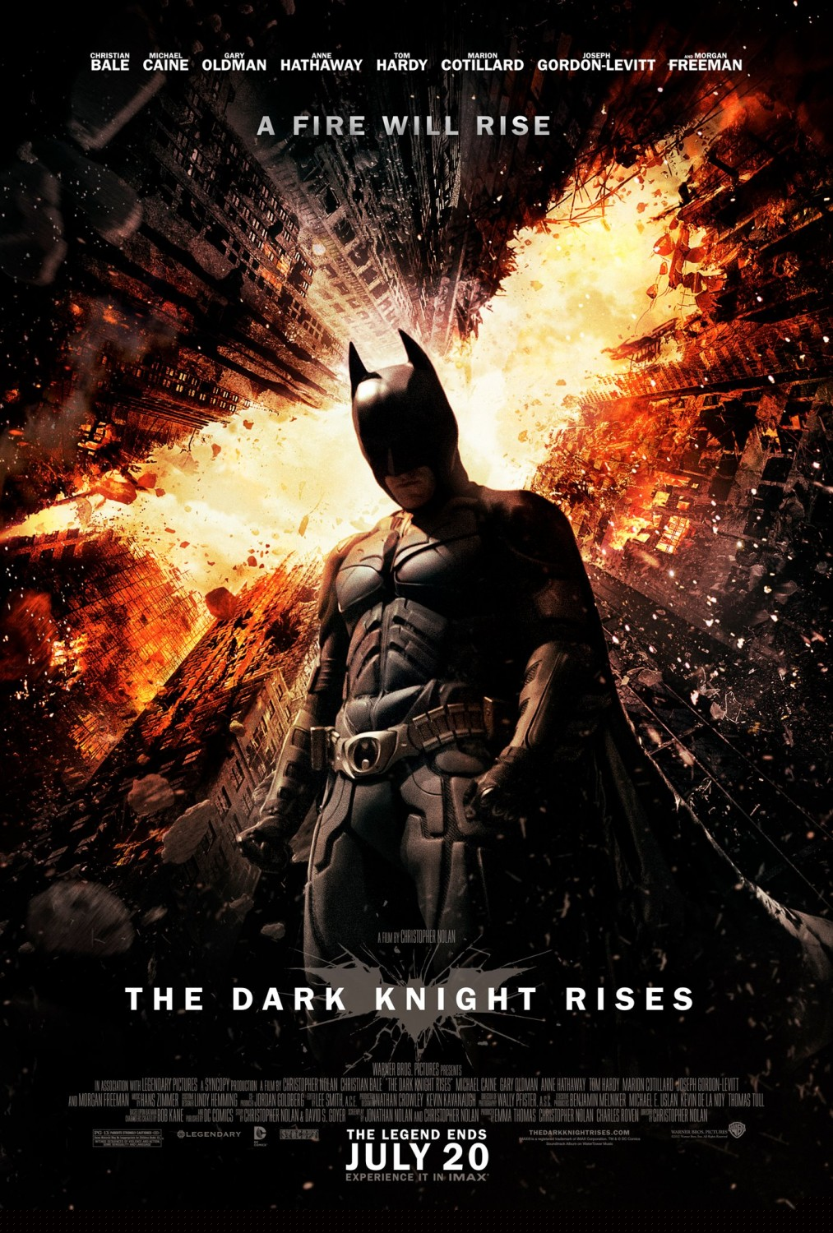

The Dark Knight Rises
Link to video
The length of the film is 2 minutes 10 seconds long which is an average length for a film trailer. It also starts with first showing the green screen at the start, then logos of each company that helped produce the film.
It shows many establishing shots of the location to give us an idea of the place of the film, another title then is shown that says ‘directed by Christopher Nolan’, this is because he is a very well known name known for other well received films such as Memento and previous dark night films. The title also has just a plain black background to draw all the attention to that.
A lot of the scenes contrast the next scene as one would have a blue tint then the next a yellow, this was both through post production and during filming with blue walls and yellow lights, I could also do a similar thing with my trailer.
There is actually little music during this, there is the national anthem at the start sung by a child to represent the innocence and then it slowly changes to a sound getting more and more tense to show the brutality of the film.
Each character is made sure to be shown although it does not show much to do with the main antagonist as this would make it better for the audience when actually watching it.
At the end of the trailer it displays the film title as well as the release date and then shows
the name of all the credited actors and producers of the film. These are all main conventions
of films trailers and I should make sure to add this into my trailer.
The costume of the main character is black which fits the home style of the film whilst also
showing that the film is going to probably have a dark serious tone to it.

Slide 5

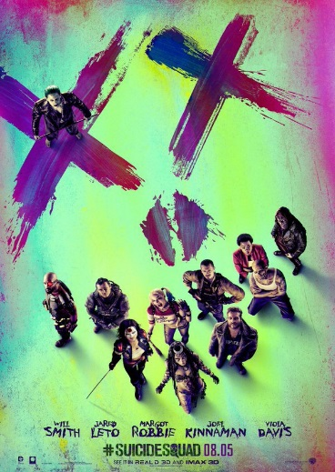

Suicide Squad
Link to video
The production company titles and logos are edited to be in the same home style as the
film with similar colours, at the same time as this you can still clearly make out what logo it
is.
The cuts in the film also match the beat of the synchronous sound in the back, this song is
also a very famous, already known song to give the trailer overall better recognition.
Characters are briefly introduced with some non diegetic dialogue of a man speaking. This
gives us an idea of their personalities and it is a taster of what they are going to be like in the
film.
As it gets to the middle of the trailer there are fast paced cuts as well as action scenes which is a very common trait in the film trailers I have seen, in this part of the trailer the music becomes louder and more fast paced.
The film will also cut to titles saying short captions giving information about the film, they are also split up so that you see ‘worst’ then a few more cuts then ‘heroes’ then more cuts then ‘ever’ I think this is to keep viewers attention because they wouldn’t click off the video after seeing the first title as they want to see more.
The final part is showing the film title which has the most popular actors names on it and then a release date is then shown after that, these titles are all the same colourful and animated font to cause the viewers to see the film as a silly film that doesn’t take itself too seriously.
After the release date there is then a link to their social media and with a ‘#suicidesquad’ which encourages viewers to use the hashtag to gain more of a following for the film.
The trailer is also 2 minutes 30 seconds long which is an average length

Slide 6
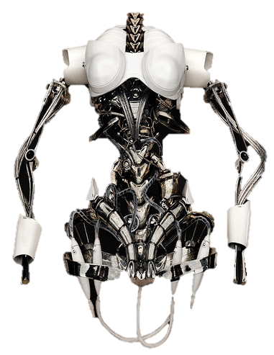
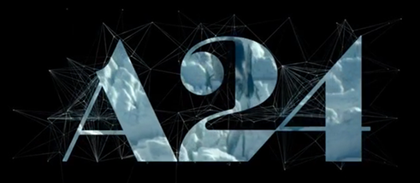

EX_MACHINA
Link to video
It begins with a very creative graphic shot of the company logo ‘A24’ where you can see the next shot that
is about to be shown through it. This then makes for a very good transition.
Characters introduce themselves to each other with voice – over dialogue which is also introducing the
characters to the audience.
The non diegetic music at the start is synchronous with the sound of the helicopter’s blades but has the style of the music in the film as well.
At the end of the film after the films title there is a shot with the website shown called ‘www.Meet-Ava.com’ which was used to research more into the film by interacting with the robot ‘Ava’, this therefore generates more interest in the film. Before this it says ‘Coming Soon’ instead of an actual release date.
The titles of the film are created with thin white lines and the background animation is also the same as this hives the film a very simplistic look. The name captions shown are lines such as ‘And Director Alex Garland’ for only about 1-3 seconds because too much time shouldn’t be wasted on the titles as they are probably uninteresting to the audience and doesn’t show enough information about the film.
The length of this trailer is two minutes thirty seconds long which is the average length for a film trailer and would be what I am also aiming for in length for when I create mine.
Most of the films I have analysed have started with some wide establishing shots the show the setting of the film and what kind of atmosphere it is going to have, in this case fields and open land is shown as this symbolises peace and tranquillity which is the tone of the film.
There is a clear difference in costume with the main character as he is entering the place since he is wearing formal clothes which contrasts Nathans clothes then as the trailer progresses the costume slowly changes to more similar to Nathans.

Slide 7
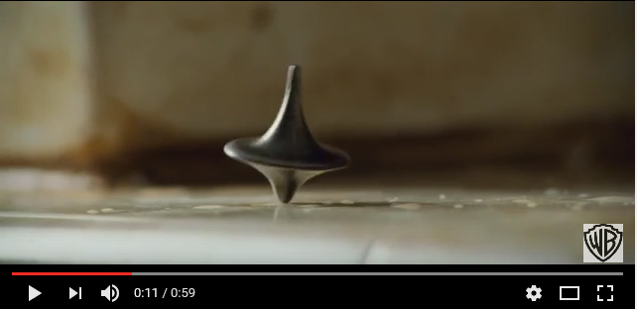
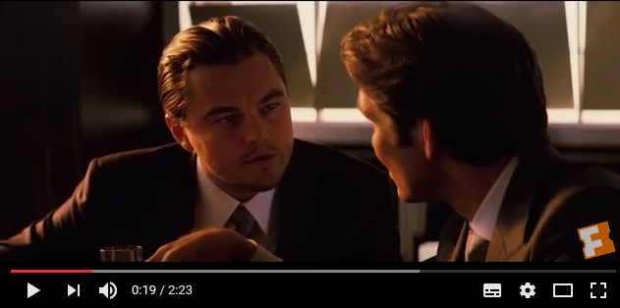
Theatrical
Teaser
-The theatrical trailer is to show parts of the film to cause the target audience to understand more of what the film is about and then decide if they want to see it.
-The length of a theatrical trailer is about 2 and a half minutes to 3 minutes long as it is closer to the actual release than the teaser trailer and therefore has much more footage to show.
-It is also used to generate more popularity for the film and what its going to be about.
-A teaser trailer is supposed to only show a very small amount that happens in the film and is only to tease the actual release of the film and to leave the audience wanting more.
-The length of the teaser trailer is only about 90 – 120 seconds long as less is aimed to be shown.
-Used to create mystery for that actual plot and idea for the film, the teaser is to also show the look and feel of the film.
-It can also be released in very early stages of the films development as they do not need that much footage to create a teaser trailer.
For Example:
Inception
2:23 minutes long
Introduces each character
Shows many scenes
Uploaded on 23 Jul 2010
For Example:
Inception
1 minute long
Not much shown
Creates mystery for plot
Released 11th May 2010

