Slide 1
11-15 Film trailers
George Nutt

Slide 2
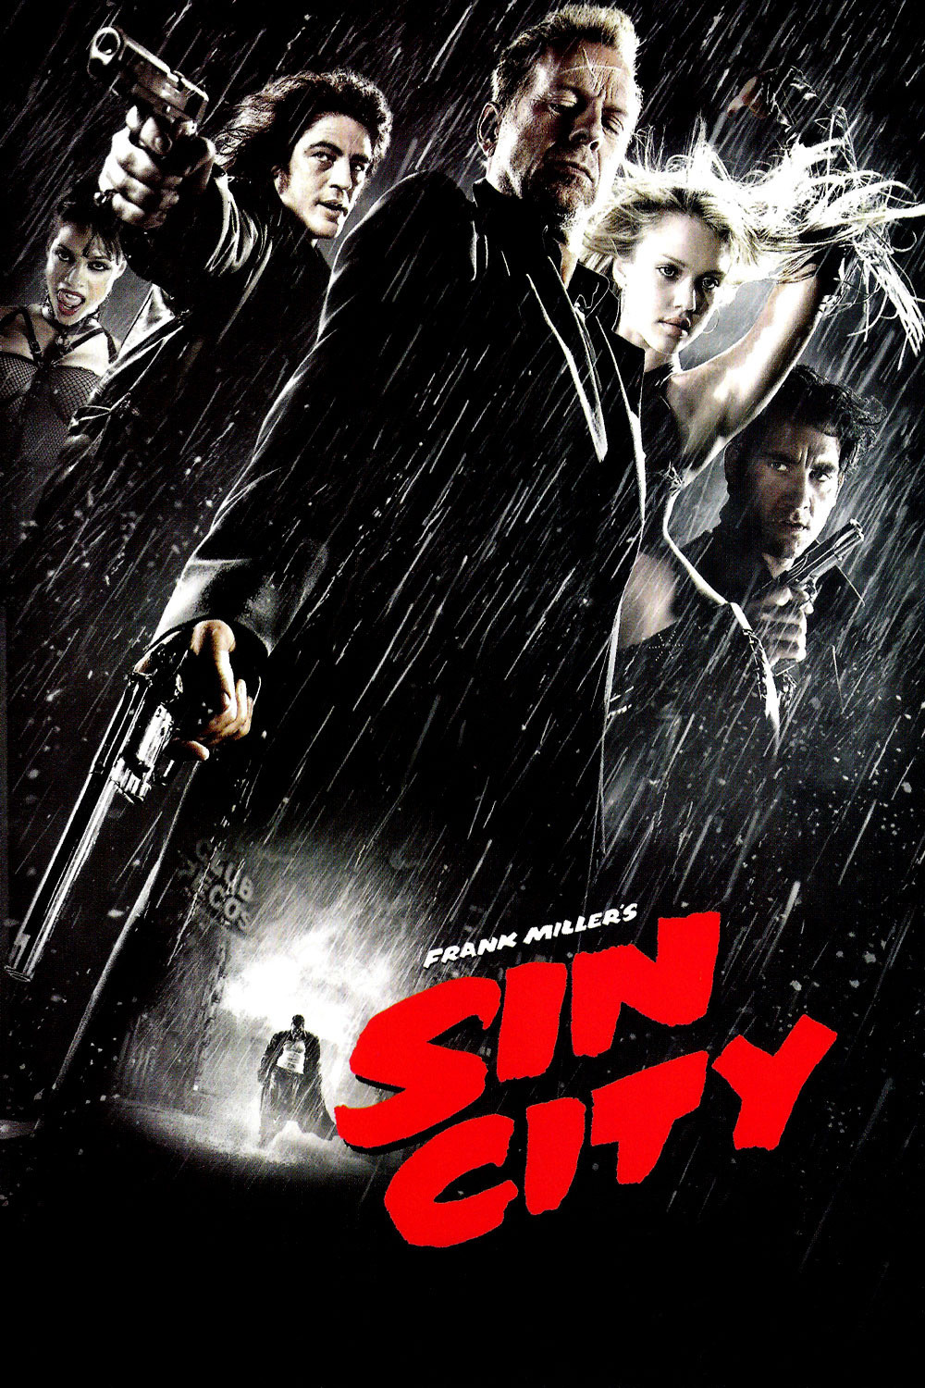
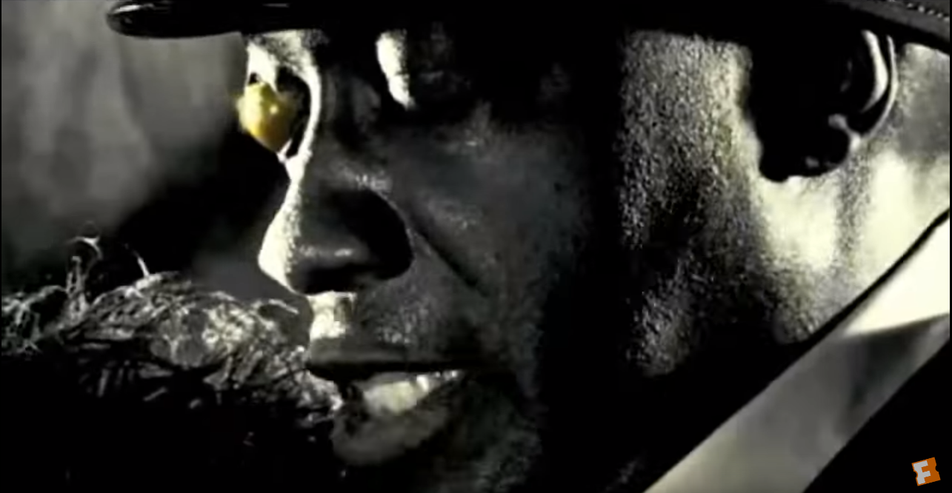
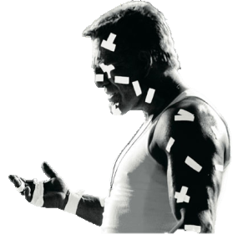
Sin City
The trailer starts with props of shot glasses, guns and cigars which instantly gives the audience an idea of how the film is going to be; an action packed crime drama. This then transitions to a graphic shot of the troublemaker studios title which then is then animated so that it explodes, this shows us that the film itself is going to be very intense.
The trailer is almost completely in black and white apart form certain objects on
certain characters such as the gold on one mans eye I think this is to emphasise the
object as well as the fact that he is a antagonist as it is a generic convention to gives
a antagonist in a film a scar or noticeable injury on their face. This effect was created
in post production.
The graphic shots that have been created are made in such a way that they look like they have come out of a comic book they have done this by using fonts that are used in comic books as well as also adding a shape that looks like a ripped out page for the background of the titles. They have done this because the entire film is supposed to be a film with comic book features and conventions rather than a film with typical film conventions.
There is then a long shot which I think may use a crane to tilt, zoom and pedestal, this shot is to establish the location and show how it looks like a comic book kind of city.
The music throughout uses an electric guitar throughout as this instrument is used to a lot to show how the film is very aggressive and action packed. At about 1:34 in the video the music completely stops, this is to emphasise the dialogue and to give us an idea of that particular characters personality.
The trailer also consists of fast paced cuts as it nears the end part of the trailer, I have found that from analysing many film trailers that it is a very common convention to have action as it leads to the end of the trailer.
During this trailer the use of slow motion is also very common as this is used to emphasise how they are capable of producing CGI so good that the audience cannot tell the difference between what is actually filmed and what was created in post production.
Link to video

Slide 3
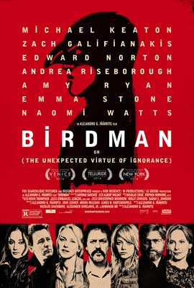
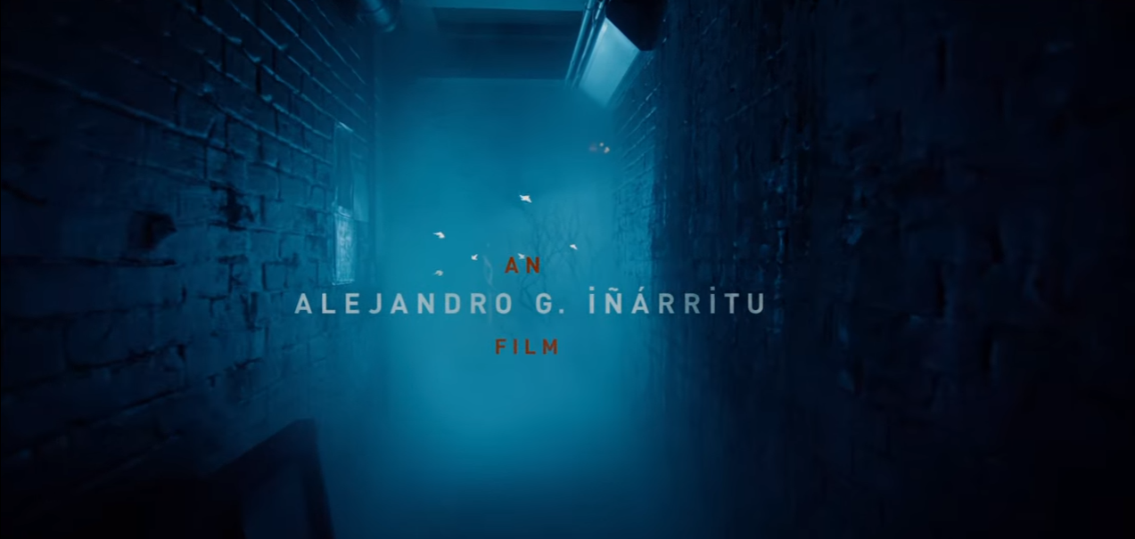
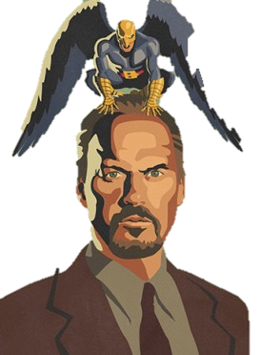
Birdman
The trailer begins with a long shot of the main character floating which causes the audience to believe that he is some sort of superhuman character, however in reality this is actually one of his hallucinations. This shows us that there are going to be strange and mysterious aspects to the film.
The narration is used effectively as it gives us an insight to the main protagonists backstory as well as also giving us an idea of his personality.
The equilibrium is established also through the narration and then when the disruption is recognised, a sad tone of music is played to show the character has vulnerabilities and cause the audience to sympathise with the character.
This then pans to a graphic shot which tells us the creator of the film. However, at the same time the blue lighting and the dirty, old location of an alleyway in the background of the title also keeps the tone of the trailer still sad.
As the protagonist of the film clicks his finger the entire tone of the film changes as a CGI
rocket shoots down and creates chaos and destruction, the roles are now reversed and
the character you were initially sympathising for is in control.
There is then a mid shot of the protagonist which pedestals down and tilts up into a low
angle shot conveying him as superior, this is then backed up by the narration of him saying ‘You are a god’. This flips the representation of the character from being vulnerable to being superior.
When the film title is shown it is very spaced out to fill the screen and also just a normal sans-serif bold font. The background is also the sky which has a black to navy blue gradient, possibly representing a change in something, like a personality, within the film. There is also the animation of the birds in the background to make the film title more interesting to look at.
The final graphic shot of the trailer is a poster for the film with various links to the film’s social media accounts which are for example: Facebook, Twitter, YouTube, Instagram and the film’s website BirdmanTheMovie.com. These are common conventions to a film trailer as they are an easy way to generate more interest for the film.
Link to video

Slide 4
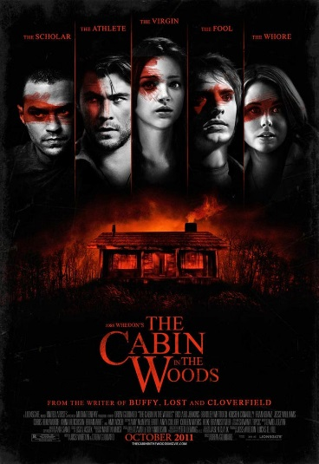
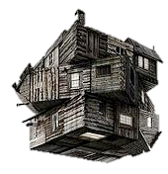
The Cabin in the Woods
Non-diegetic music starts off happy and high pitched to mislead the viewers into thinking the film is going to have a positive joyful tone. The location of the old, abandoned house then introduces a scarier tone to the film. Also, when the character comes out of the house he has a dirty, old costume which portrays him as an unpredictable character.
A title appears saying ‘you think you know the story’ this quote would change viewers' expectations of the film as before they would be expecting a generic horror film but after that title they know it is going to be something more unconventional.
Special effects are used to create the effect of a sort of force field around the cabin, it also shows us that the protagonists are stuck in some sort of simulation and somebody is in control of what is happening.
The fade from black transition is used to introduce a long shot completely different location which is a control room controlling everything that is happening within the film. Because of this it means the film becomes very postmodern. The control room is also very well-lit whereas the cabin has a lot of low key lighting, this is a juxtaposition between the two locations and shows how they are opposites.
There is a point of view shot of one of the ‘damsel in distress’ characters look at their friend in a lake which then cuts to a close up of the damsel in distress screaming however this quickly cuts to a title before you can see what has happened. This is an equivocation as there is an incomplete answer to the question of why was she screaming, this creates a lot of mystery and causes the audience to carry on watching to see if they can find out more information.
There is a match on action with a button being pressed by a character that is middle aged and dressed in a white shirt showing him a some sort of professional. It matches where he presses the button and an explosion created by CGI appears in a different location to where he currently is.
A title pops up during the fast paced cuts nearer the end of the trailer saying ‘this April’ hinting at the release date, this is common within trailers and I think I would do something similar in my trailer as it makes the trailer look more conventional.
The final film title is the same style as the titles that were popping up during the trailer with the serif white font with red features to it. After the title there is also another clip which teases what is going to happen in the film as it finishes on a close up of a character screaming in fear or something we cannot see.
There is a sound bridge of the previous scream that continues in the background of the final titles which are graphic shots of the word ‘coming soon’, further links to their social media like their Facebook and the hashtag ‘discoverthescecret’ and the production company logos below it all in a small font.
Link to video

Slide 5
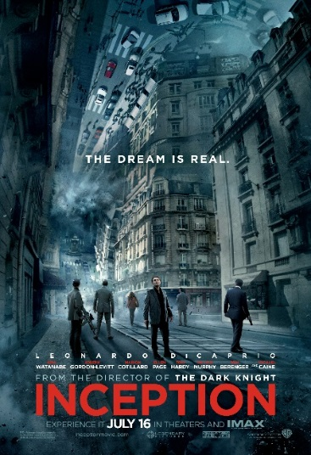
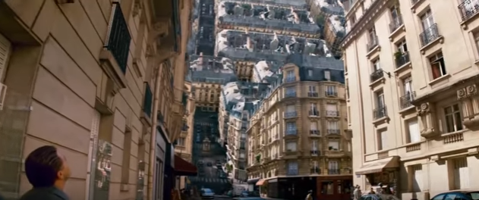
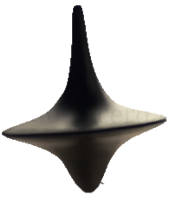
Inception
The trailer begins with a pleonastic low pitch sound, this is to catch the audience’s attention as it would probably shock them if it was to happen in a cinema. There is then a mid shot that gives an idea of what the main character is like through showing his costume, a suit, and the prop of a gun. This tells us he is probably going to be some sort of professional assassin sort of character. A title then pops up saying ‘The extractor’ explaining his role within his group.
There is then the mentor that is introduced through the dialogue ‘I never taught you to be a thief’, by using the word taught it shows us that he was the one to guide him to be a professional.
13 seconds into the trailer there is a long shot of unknown characters frozen floating which illustrates that in the film there is going to be something supernatural to it, this along with the narration in the background talking about dreams gives us an idea of the focus of the film.
Another title then pops up say ‘the point man’, this then cross cuts straight to a character who we now know is known as ‘the point man’. They then explain what a ‘kick’ is an whilst they are doing so they are able to show stunts in the film that twist reality with people falling upwards or sideways.
One of the sidekicks in the film have the stereotypical traits of a sidekick like being smart but not as smart as the main protagonist. The only thing that isn’t stereotypical about the character is the fact she is female.
Special effects are used a lot in this trailer, this gives an idea of what they are going to
be like in the film which is extremely ambitious with effects like the street folding in on
itself. Slow motion is also used very often to emphasise some of the effects
There is a high angle shot at one point which pedestals downwards whilst tilting to
keep the character being held over the stairs in the shot. This makes the danger that
the character is in much more exaggerated and gives us an idea of how far down it is going to be and could make the audience feel the Acrophobia.
Link to video

Slide 6
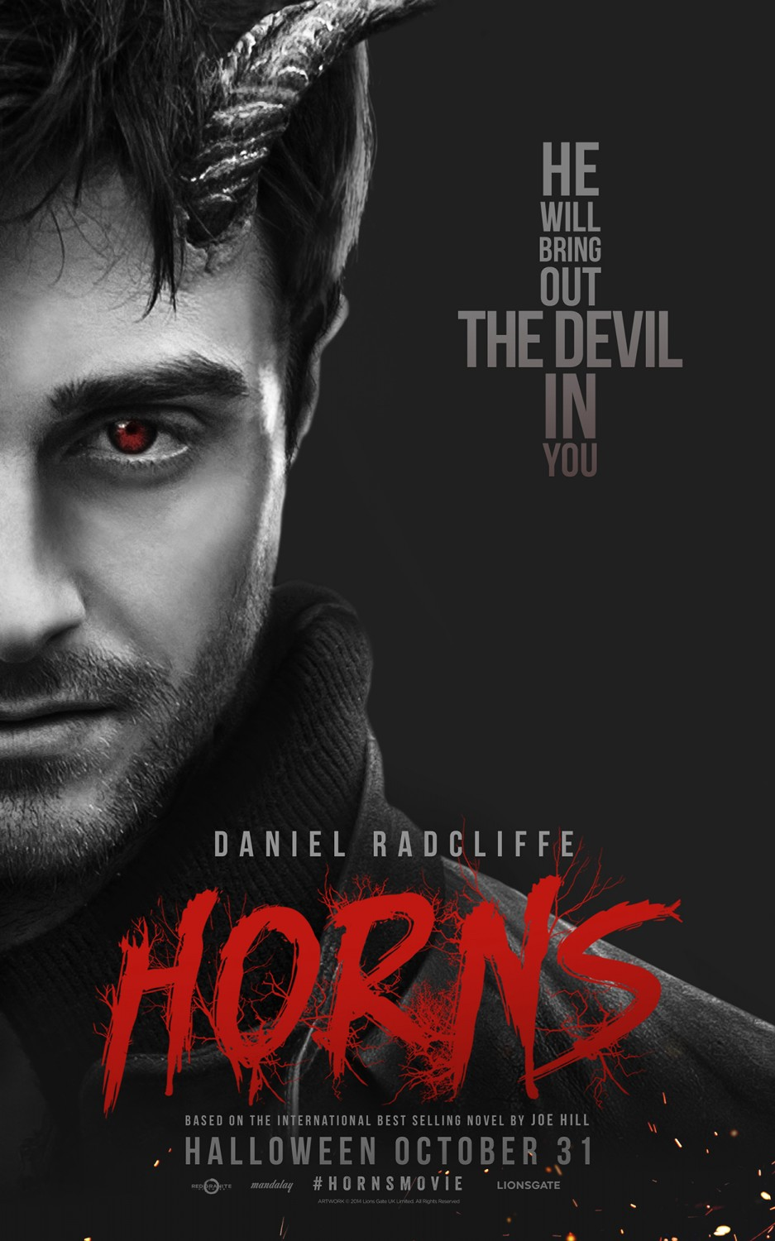
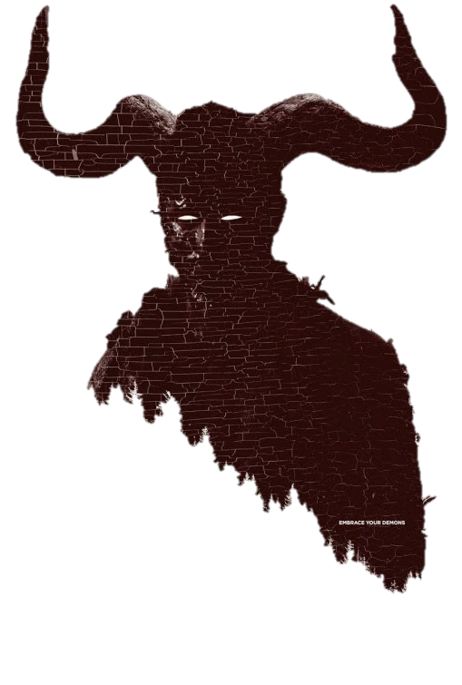
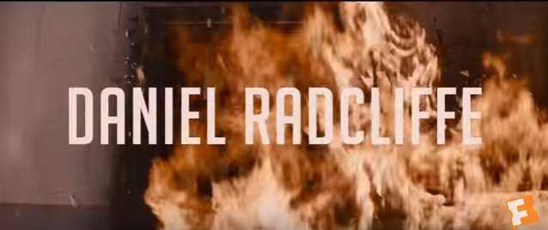
Horns
The first sound we hear is the non-diegetic sound of a guitar, this is often used to portray a happy tone to the audience. This sound linked with the camera shot of two people kissing gives the impression to the audience that the film is going to be of the romance sort of genre. This is a kind of snare under the hermeneutic code as it avoids the truth that the genre is more of a thriller.
There is then a shot of the main character laying with his girlfriend then as she says ‘just love me for the rest of mine’ there is a transition that is made to look as though the camera pedestals down to the underground. As the transition finishes there is a mid shot of the character laying with everything flipped upside down, the colour is desaturated in post production and the prop of alcohol, this is done to show the other ‘darker’ side to him.
There are then two of the production company logos that are animated to match with the synchronous sound of the guitar, they are also near the start of the trailer, I have found that this is common in trailers and I think I would take inspiration and make sure my company logo is shown near the beginning of my trailer.
The transition of fade from black is also used to skip the less important parts and just show one clip of him leaving his house, fade from black then a clip of him at his car being harassed by the protestors.
The titles are then made to look almost evil with a red background which has connotations of blood and death. There is synchronous sound with the title appearing and the sound of a cymbal from a drum.
More instruments are slowly introduced throughout the trailer as it gets more intense and action packed. As well as this there are lots of faced paced cuts edited in, this is to make the audience believe that the film has a lot of action.
              For the titles of the actors and actresses, the background for them represents their character, for example in the one for Daniel Radcliffe there is fire, which has connotations of danger, pain and evil. This represents Daniel Radcliffe’s character as he is slowly becoming the devil.
Link to video

