Slide 1
16-20 Film trailers
George Nutt

Slide 2
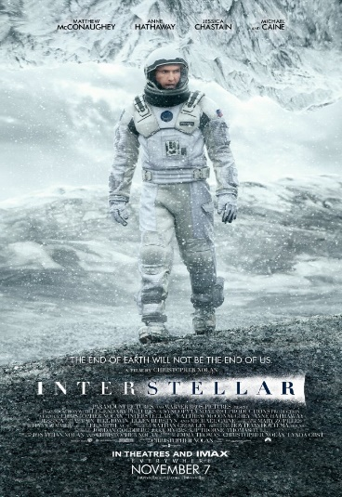

Interstellar
Character is introduced to be smart through the narration of him explaining about the surveillance drone to others and then one of the characters calling him a ‘well educated man’.
Transitions are very slow and are mainly fade from and to blacks, this gives a calm feel to the start of the film and in addition to this there is also the location of the cornfields which are often used in films such as man of steel to give more of a peaceful tone to the film.
Non-diegetic music is higher pitch using instruments like violins, more and more are introduced as it gets closer to the climax to the trailer ensure there is a lot of tension as it leads up to the ‘big moment’ of a part of the ship being destroyed.
Titles are also introduced very slowly and they fade with no extravagant colours or special effects as this would ruin the calm tone to the start of the film.
A lot of non-diegetic narration is used throughout to introduce the characters, we can tell who is going to be the mentor type character through him saying ‘nothing in our solar system can help us’ as this shows he is talking to the main protagonist in such a way that he is seen as smarter than him. We can also tell who is going to be the damsel in distress through the line ‘I have no idea when you’re coming back’ narrated by a girl child.
There is a match on action to the protagonists face before looking at a rocket then it cuts to the rocket with him in front of a low angle shot from the camera looking up to the rocket to make it seem huge compared to him.
There is a lot of special effects used in this trailer for things such as the rocket taking off in the distance and half the cornfield set on fire, this is used to symbolise the peace being destroyed and the equilibrium within the story being disrupted.
Link to video

Slide 3
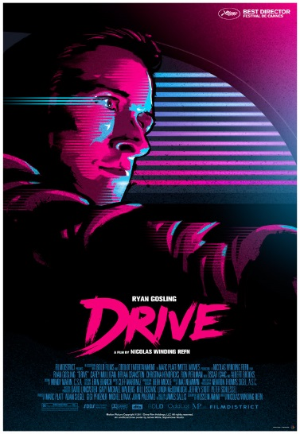

Drive
The prop of the clock on the main protagonists wrist is like a totem for the character to represent his personality which is strict and very routine with no exceptions. This point is further backed up with his lines which are “In those 5 minutes I’m yours, I do not carry a gun. I drive”.
There is a high angle shot as the protagonist meeting with the character Bernie Rose, this looks down on him as vulnerable when up against this other character and also fits with the dialogue of the mentor character calling him ‘kid’.
Just before the high angle shot of the character there is a low pitched noise and the music stops so the line that the character says is emphasised more.
The father is portrayed as an unreliable character through his costume with a white vest top as well as the blood as make up on his face and shirt.
Fast paced cuts of the main protagonist driving the car to create tension and make the scene seem more action packed and as though it fits the action adventure genre. A prop of money is then used just after the fast paced cuts as this gives us an idea of what the plot and the action are about
During the end of the trailer the music is purposely unfitting to the trailer as it is positive orchestral music with shots of people being beaten, gun props being fired and blood being shown, this is a way of emphasising the violence as the audience would see it and notice the fact it doesn’t fit with the film.
The ending to this trailer is different to most endings of trailers as it ends with an establishing wide shot of the location of the film whereas most films trailers start with establishing shots to give us an idea of where the film is going to be set, whereas doing it like this means that the viewer would remember the location of the film and would therefore have the idea that the film is revolves around the cinematography aspect of the film
Link to video

Slide 4
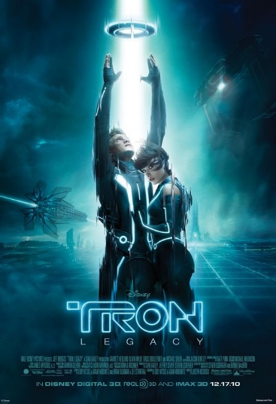
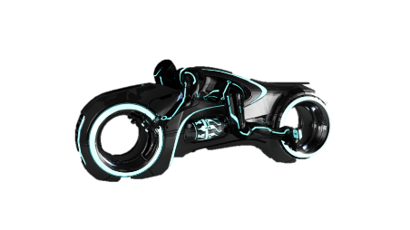
Tron: Legacy
There is a graphic shot of the production company logo is animated in a way such that the colours slowly change to the thematic colours of the film which are a light blue which is often used to convey that the genre of the film is sci-fi and it is a colour often associated with technology and games.
The non-diegetic music from the start slowly begins the build up to when there is going to be the destruction of the equilibrium shown in the trailer. This music is in the background of the narration which I think would be good to do in our film as it means the audience would get the feel for the film subconsciously through the music as well as through the narration.
The costumes of the two characters shown, one a mentor and one a normal young protagonist, are contradictory with the mentor wearing formal suit and tie clothes whereas the younger protagonist has only the costume of a t-shirt this is a good way of expressing both the character’s personalities.
The costumes, props and the location are filled with bright blue led lights, this is to portray the fact that the characters actually are in a video game. By using this ambitious lighting and effects it means that it is clear for the audience to differentiate between the video game universe and the normal universe.
The antagonists are easily portrayed through the lights on their costume being orangey/red, I think most of this is done because the film is for a younger target audience so the film creators made it easy to differentiate the bad characters from the good.
There is a cut from black that synchronises with a low pitched loud sound effect as it shows an extremely large object, this is to emphasise the size of it and how menacing it is, I could do something similar with our film when showing an object, person or location that needs emphasis.
There is the location of the abandoned arcade that is used, this is a good location to use considering the genre and type of film that it is.
Link to video

Slide 5
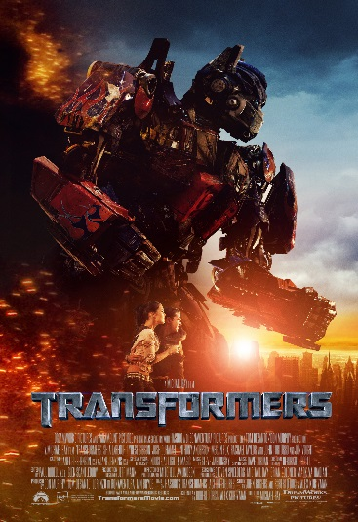
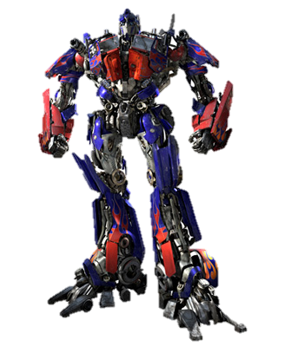
Transformers
The trailer for the film starts with a dolly mid shot of, presumably the main character driving, this puts emphasis on the movement and of cars, it then transitions from this scene to the next one through using a fade to black then a fade from black, this indicates the change in location. The new location is a car sales place, this further indicates the film’s relation to cars.
There is a close up of the radio in the car, during the close up there is the diegetic sound of a distorted radio noise, this is also synchronous with cuts to and from black in an extremely quick succession to cause the audience to know that there is something mysterious or something wrong with the car he has just entered.
The size of the robot is emphasised by the pan upwards from the bottom of the robot to the top, this creates a low angle shot which allows for people to see the robot as superior and extremely tall.
There is also a close up of a character’s face who is wearing a costume of a suit and tie, this conveys him as a professional smart character. The close up shows his emotion as amazed, this then cuts to a point of view shot from the character’s view, this then a similar shot to the one mentioned earlier as it is a low angle shot of the huge robot shown to make it look superior.
The background music completely stops so that it can emphasise the diegetic dialogue which is a man shouting “we are under attack!”. Just after this, it transitions to fast paced cuts and absolute chaos caused by CGI and special effects. This would surprise the viewer as it is a complete change of tone as the music goes from absolute silence to extremely loud.
The plot of the film is smartly described through a sound bridge of diegetic sound to non-diegetic sound of a man doing a speech describing what is happening.
There is the non-diegetic voiceover of a man saying “They could be anywhere” this is followed by various ambitious locations such as a dessert.
There is low key lighting which has connotations of evil and negativity and when the robot turns up it is covered in bright lighting which has angelic and positive connotations, this represent how it has come to help rather than making things worse.
Link to video

Slide 6
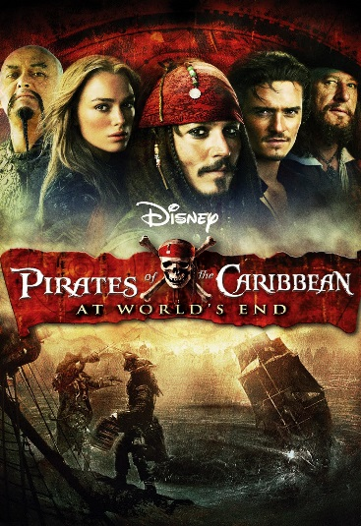

Pirates of the Caribbean
The trailer begins with an extreme long shot of the pirate ship to instantly tell the audience that the film is going to be a pirate themed, action adventure genre film. This one shot then transitions to the production company logos by fading to black, as they finish it also fades back from black to give the sense that the logos are not part of the film.
The costume of each character is creased dirty clothing to emphasise the poor conditions, this is also done through the low key lighting shown in the same scene.
There are fast paced cuts of people shooting guns during the first part of the film, this is to add mystery as to what is happening in those scenes raising questions like, who were they shooting at? Why were they shooting at them? It is also a way of telling the audience that there is going to be action involving the props of guns and various weapons.
There is CGI on almost every antagonist’s face. This is to show how they are different to the normal protagonists and to viewers they would be seen as horrible and repulsive. Also it could be seen as giving the antagonist a disability which is often done in films for example: Captain Hook in Peter Pan, this is a disability for him however it also acts as a totem and something that he is defined by. A similar thing can be said about the antagonists in this where they have deformities on them but it also defines them.
From certain diegetic dialogue in the film you are able to tell that it is partly of the comedy genre, the background music gets quieter as the dialogue begins to emphasise the comedic line said.
The graphic shot of the titles between each shot say things like ‘Walt Disney Productions presents’, I will do something similar within my film as it is common in most trailers. Also it is in yellow writing with a red background as this is a similar style to the main title however not exactly the same, I will also do a similar thing with my film trailer.
As the trailer nears the end the non diegetic choir gets louder and higher pitch to add tension and cause the audience to believe that something is going to be revealed at the end of the trailer.
It then ends with a graphic shot of various names of the cast members, then finishes with the link to the website as well as the various social media on the last page.
Link to video

